Slide 1
Law Meets Practice: Common and Complex Scenarios
Justin Bates KC,
Landmark Chambers
Cassandra Zanelli
Property Management
Legal Services

Slide 2
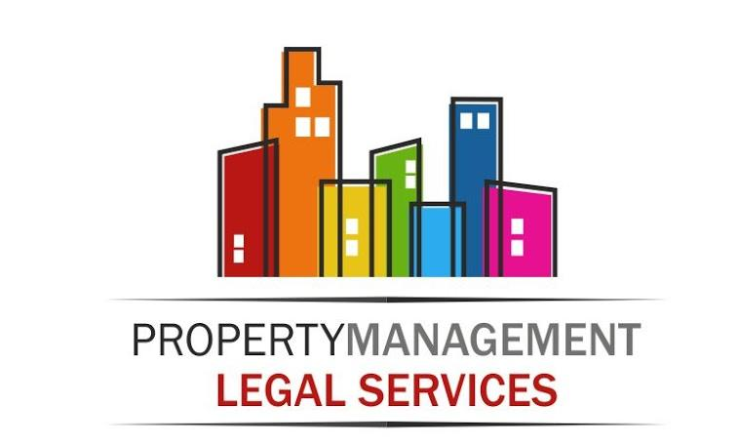

Legal update:
Cassandra Zanelli, Property Management Legal Services Limited
Justin Bates KC, Landmark Chambers

Slide 3
Law meets practice: common and complex scenarios
Building safety
Insurance

Slide 4
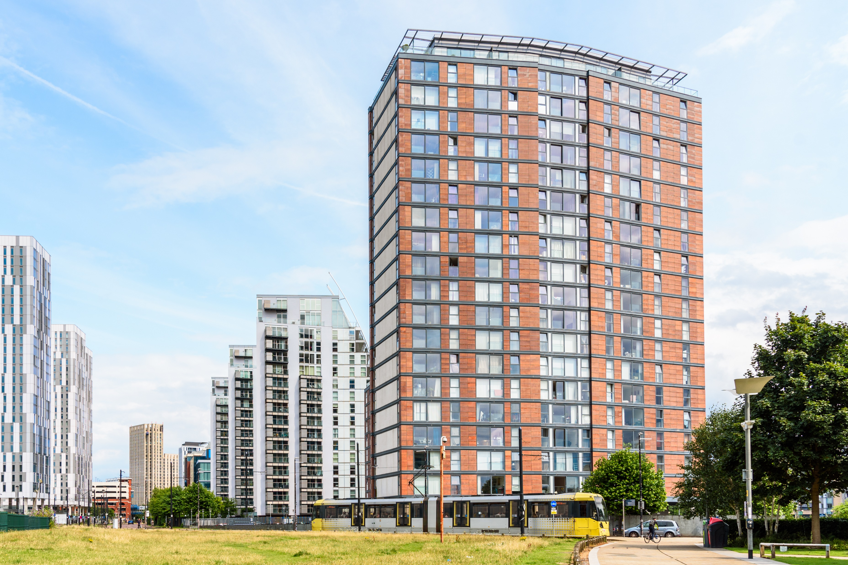
Scenario one: building safety
    1st January 2024: management starts
    Building: constructed 2009
    60 metres and 20 storeys
    Healthy reserve fund and no significant service charge debt
    Engaged leaseholders
    1st August 2024: fire safety defects discovered
    Served with notice by relevant authorities
    What do you do?

Slide 5
Scenario one: building safety (2)
  How does this play out?
  Private freeholder
  Lessee owned freeholder
  RMC/RTM company
  Right of first refusal offered

Slide 6

Scenario two: Insurance
    Insurance placed
    Premium: £100,000
    £20,000 comes back to you
    What do you need to think about?
      Does it matter if the client is a FH? RMC/RTM?
      In any event, what duties do you owe leaseholders?
      What work are you actually doing?

Slide 7
Scenario two: Insurance (2)
    Same building, different year
    Building safety defects discovered
    Premium £1 mil
    £200k comes back to you
      How does that change matter?

Slide 8

Any Questions?

