Slide 1
Psychological Safety:
What, Why & How?
Jonathan Peach
Art of Brilliance

Slide 2
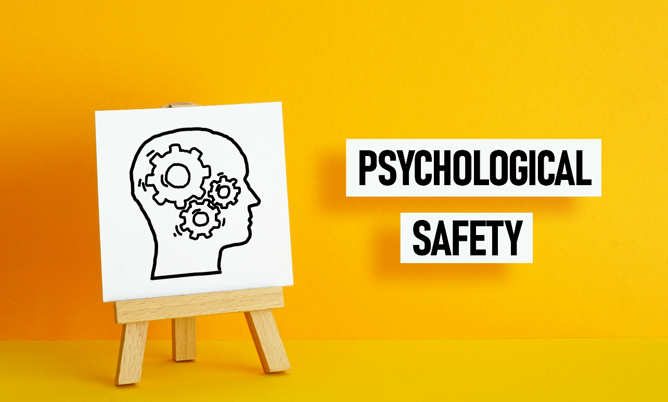
CREATING AN ENVIRONMENT FOR INNOVATION AND CHANGE
PRESENTED BY JONATHAN PEACH
ART OF BRILLIANCE

Slide 3
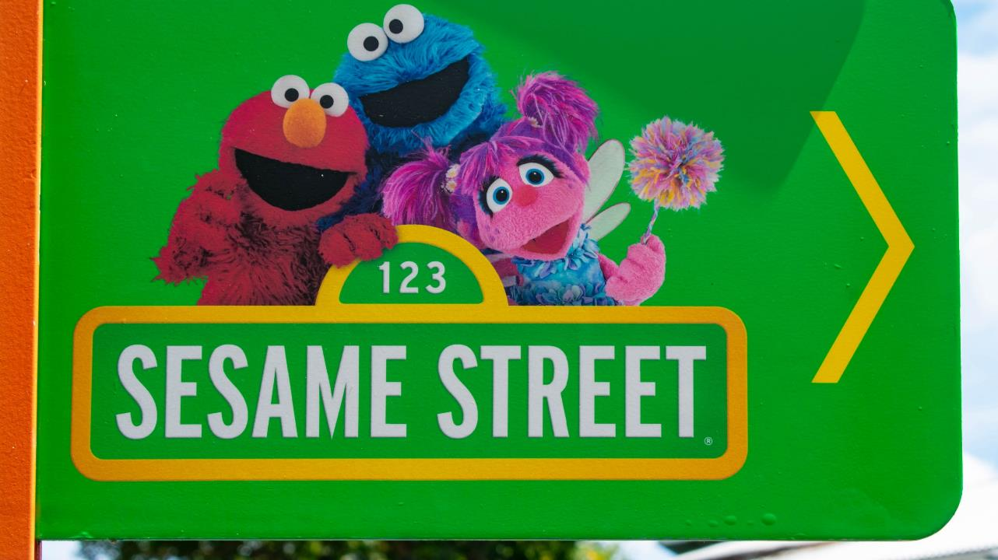

Slide 4

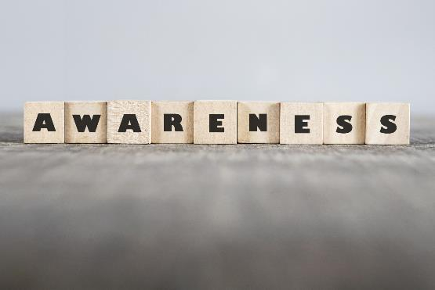
repetition

Slide 5
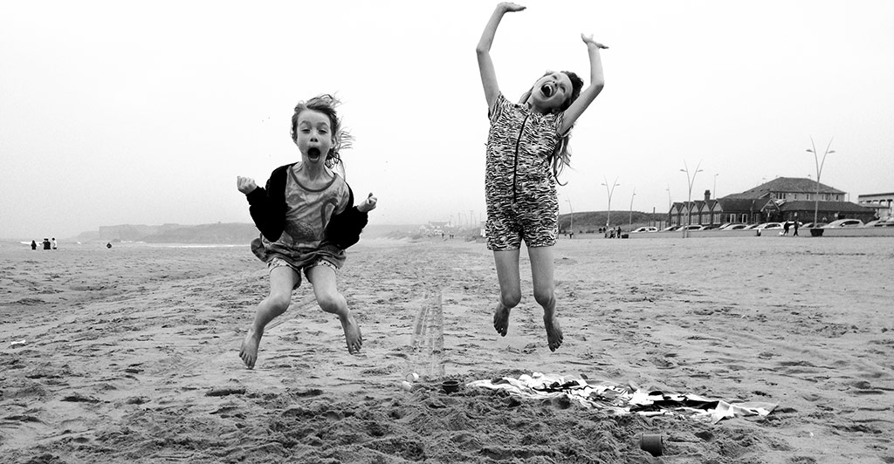

Slide 6

Describe you at your best?

Slide 7

P=p-i

Slide 8
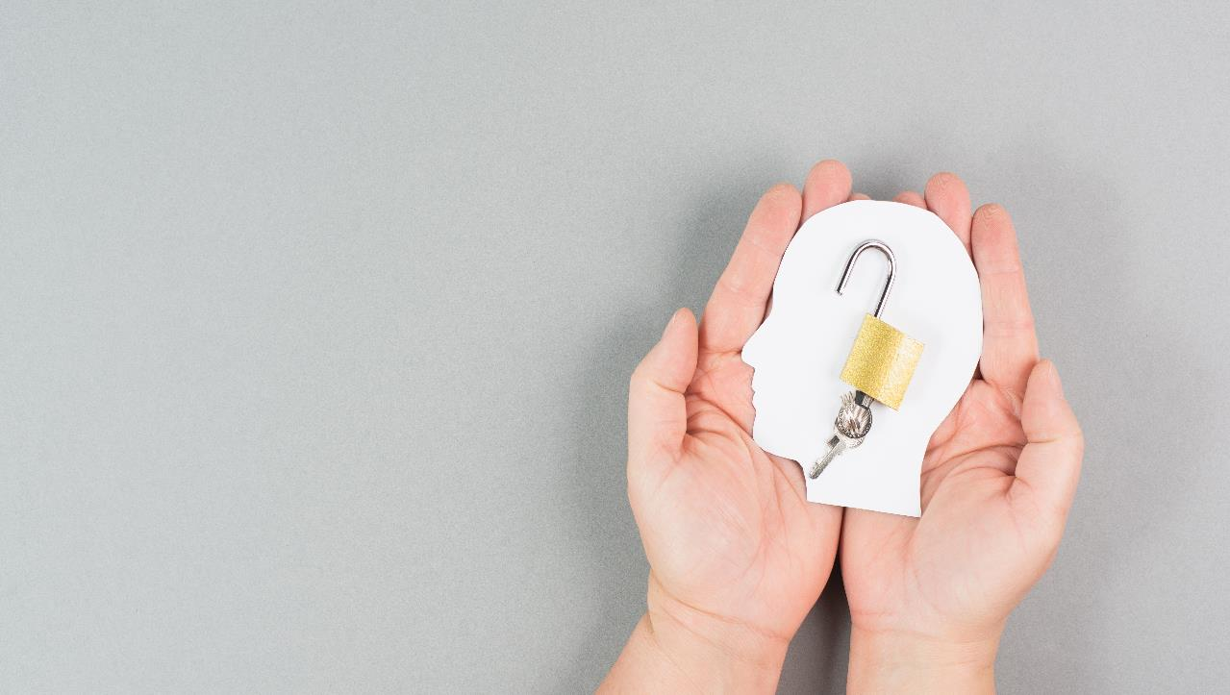
HAVE YOU EVER?

Slide 9
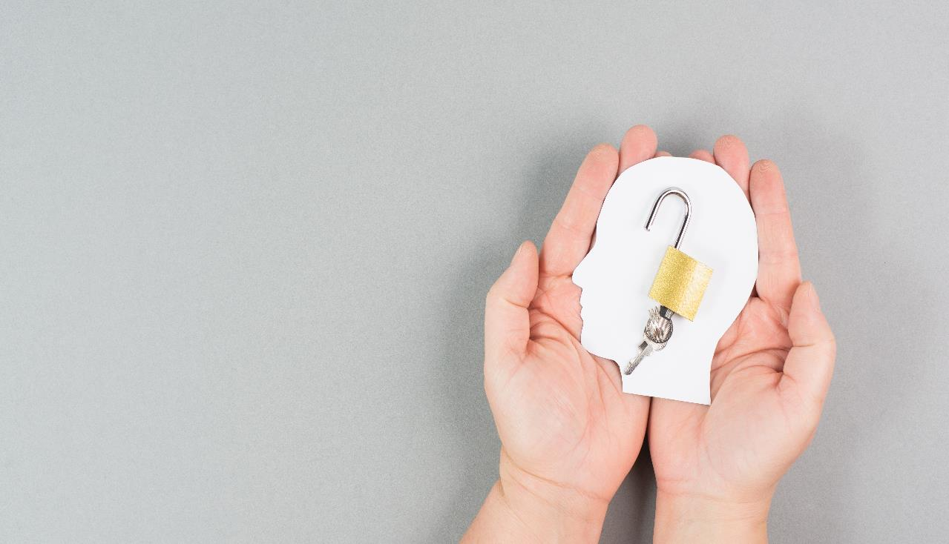
Thought – I would rather keep my job by staying within the lines than say something and risk looking stupid?
Not said anything in the meeting because you didn’t want to bring the mood down?
Agreed to something you weren’t sure about just because you didn’t feel comfortable saying it?

Slide 10
Experienced a moment of silence in a meeting when you
are all waiting for someone to speak?
Have a question nobody else seems to be asking and said
to yourself “don’t worry I’ll figure it out later”?
Have you ever got up in the morning jumped out of bed
and thought, WOW I can’t wait to get into work and feel – Ignorant, Incompetent, Intrusive & Negative.

Slide 11
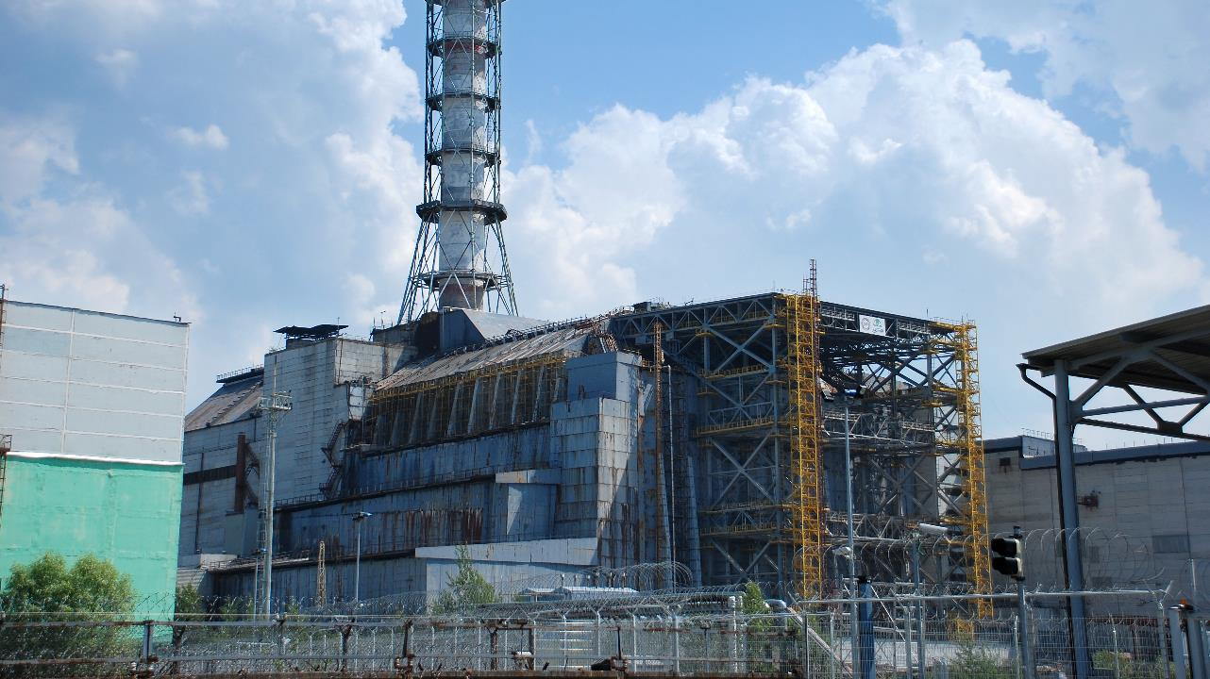

Slide 12

1st February 2003
January 16th, 2003
• Test Launch - piece of foam fell off and hit the wing
January 21st Review Meeting
﻿﻿ Engineer Rodney Rocha selected to inform his superiors to consider
the wing's possible damage but he was brushed aside.
﻿﻿ One manager told Rodney Rocha to stop being a 'Chicken Little.'

Slide 13
What is it ?

Slide 14

“A shared belief held by members of a team that no one will be punished or humiliated for speaking up, with ideas, questions, concerns or mistakes.”
Amy Edmondson - Harvard

Slide 15

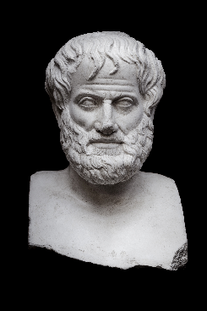
PROJECT ARISTOLE
Notes:
Following the success of Google’s Project Oxygen research where the People Analytics team studied what makes a great manager,
Google researchers applied a similar method to discover the secrets of effective teams at Google. Code-named Project Aristotle - a tribute to Aristotle’s quote, "the whole is greater than the sum of its parts" (as the Google researchers believed employees can do more working together than alone) - the goal was to answer the question: “What makes a team effective at Google?”

Slide 16
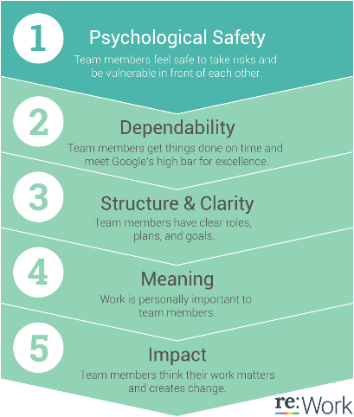
HIGH-IMPACT PRACTICE: GIVING VOICE
  What makes a Google team effective (as determined by evaluations and sales performance)?
  2-year study, 200+ interviews
  Looked at 250 attributes of over 180 Google Teams
  Of the factors determined to make an effective team, the top factor was Psychological Safety.
Google (2019) ‘Project Aristotle’ – retrieved from:
https://rework.withgoogle.com/print/guides/5721312655835136/

Slide 17
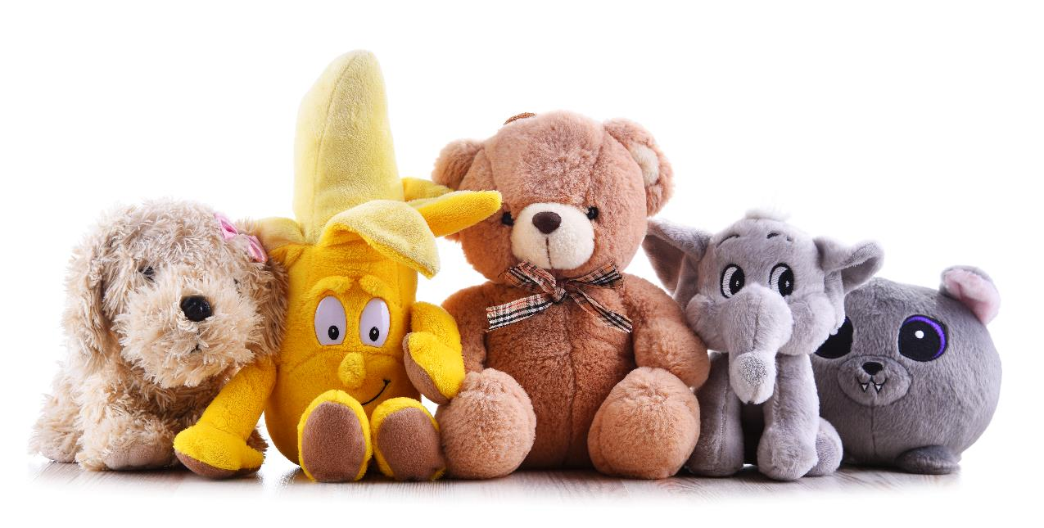

Slide 18
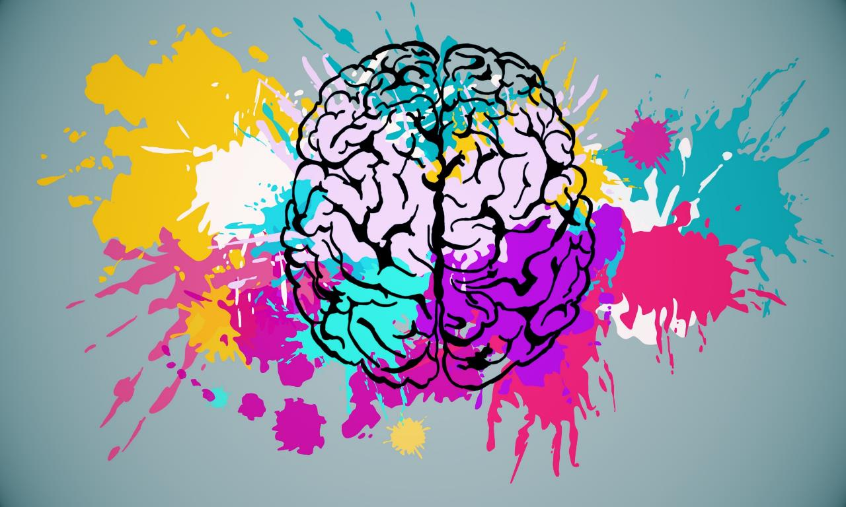

Slide 19
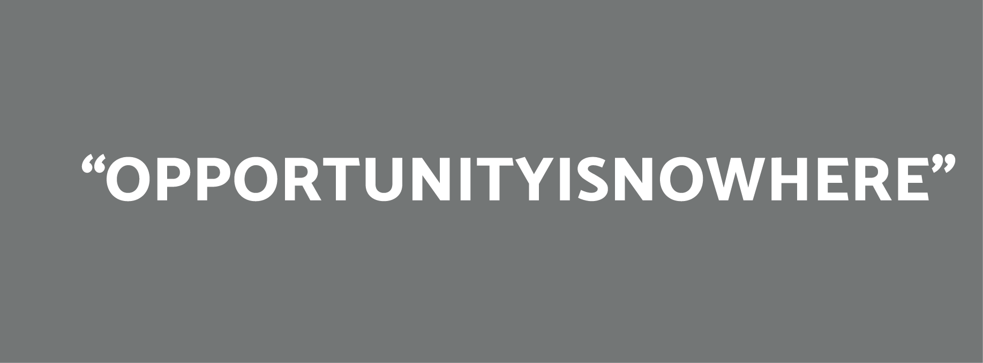

Slide 21

Increases our attention span, because we're not distracted by
negative thoughts.
Makes us more intuitive and creative, because we're not afraid
to think in risky ways.
Helps us to develop resilience, because we have more ‘mental
capacity’ to deal with problems.
Improves our physical health, because we're under less stress.

Slide 22

Team Psychological Safety
When present
When missing
More Engaged
Opinions Expressed
Better Decision Making
Continuous Learning
Better Results
Employee Well-Being?
Stress/Burnout
Turnover
Poor Performance - sometimes deadly consequences

Slide 23
PSYCHOLOGICAL SAFETY
C
B
T
onnection
elonging
rust

Slide 24
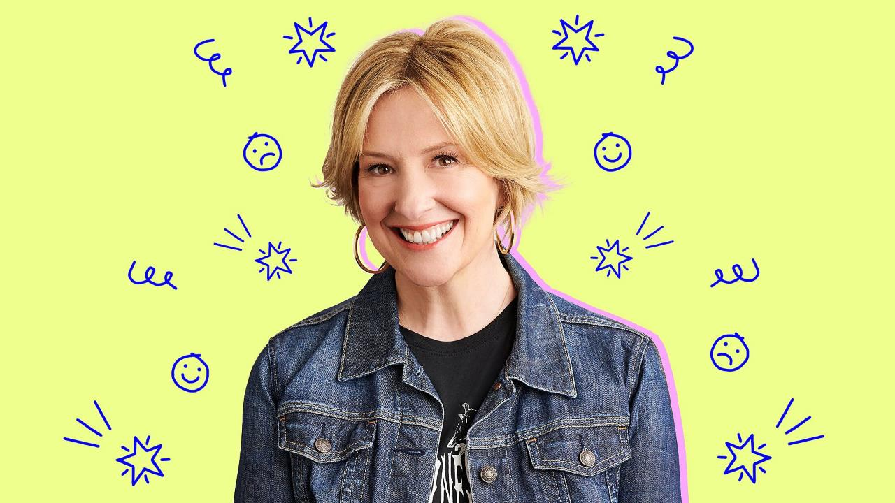
“the energy that exists between people when they feel seen,
heard, and valued; when they can give and receive without
judgment; and when they derive sustenance and strength from the relationship.”

Slide 25

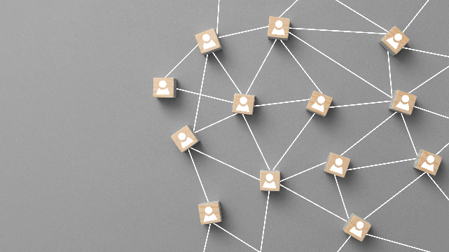
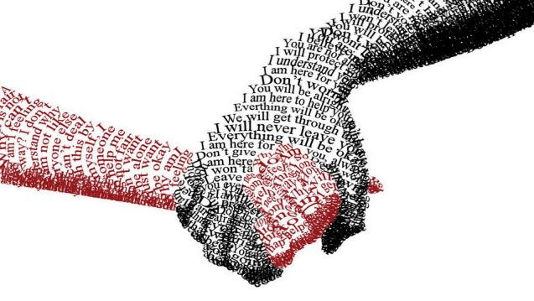
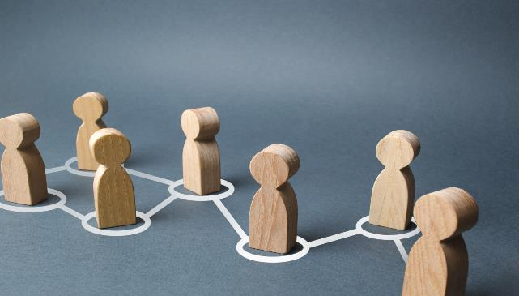
CONNECTION
Notes:
CONNECTION.
As human beings we are hard wired for it, we survived and thrived in groups and that’s still the case today, it what gives our lives meaning and purpose.
world we’ve been through a pandemic, hybrid working and working from anywhere is common place and research in the US would indicate 65% of people feel less connected with their work colleagues than before if connection is so important to us as human beings and if we are to unlock psychological safety in our teams, we have to do something about it. A 2019 report by the Institute of Leadership and Management found that building close relationships with colleagues was the most important factor in determining job satisfaction by 77% of respondents (salary by the way was eighth – just sayin) Gallop in their Q12 engagement survey report that only 20% of people have a ‘best friend at work’ but those that do are seven times more engaged. In fact, those with a best friend at work are more likely to engage customers, produce better work and have high well-being.

Slide 26

What sort of things can you or your company do to foster better connections at work?

Slide 27
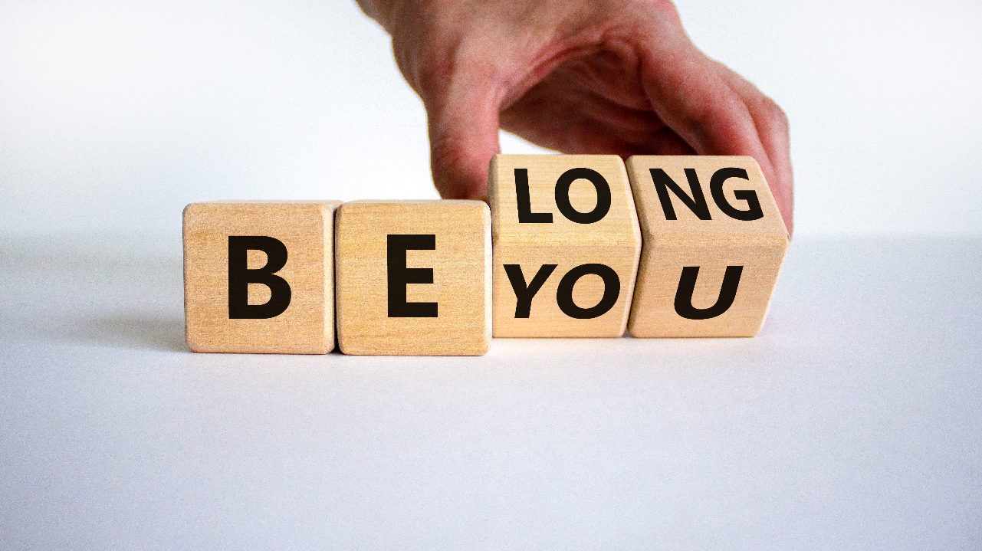

Slide 28
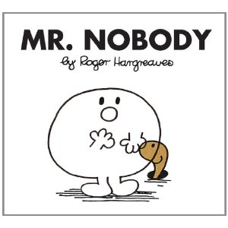

Slide 29
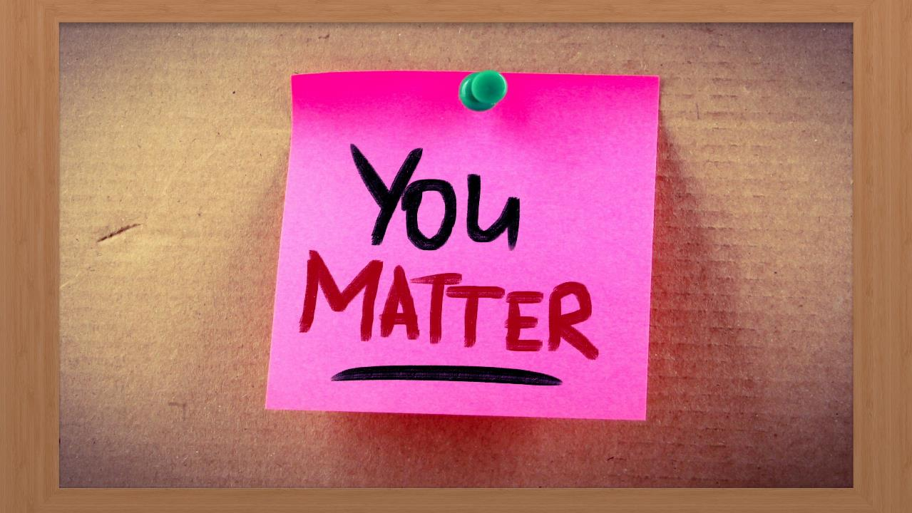

Slide 30
Mattering is the belief that we’re a significant part of the world around us, it’s the belief that we’re noticed, important, and needed — right now.

Slide 31
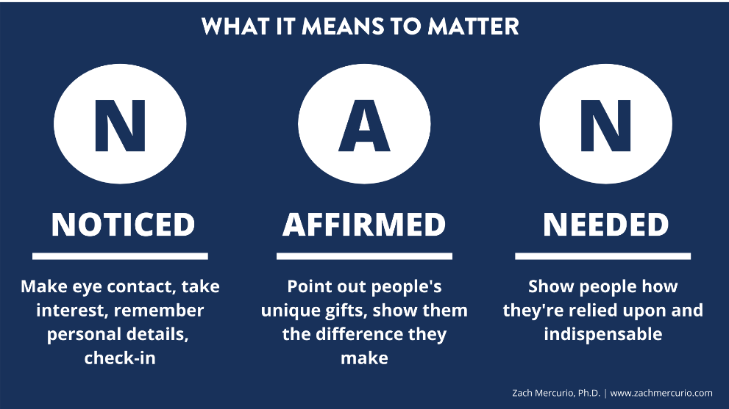
Notes:
NAN, computer language “Not a”

Slide 32
ONE MOMENT OF MATTERING CAN…
Increase self-worth
Increase motivation
Increase serotonin, oxytocin, & dopamine
Lower depression
Lower anxiety
Lower stress
Sources: Flett et al. (2018)
Notes:
NaN – computing – not a number

Slide 33
Notes:
NAN, computer language “Not a”

Slide 34

NOTICED
Make eye contact/show attention/smile
Ask about & remember personal details
Check-in regularly
Invite people’s opinion
Notice the small things.
Notes:
The check in regulary is interesting
ADPRI data 50,000 globally
Leaders who check in weekly have engagement scores 77% higher
Voluntary turnover in the following 6 months down by 67%

Slide 35
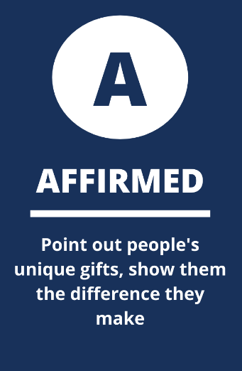

Slide 36
AFFIRMED
Give purposeful affirmation
Point out people’s unique gifts
Express regular gratitude
Notice the little things people do
Create a climate of psychological safety.

Slide 37
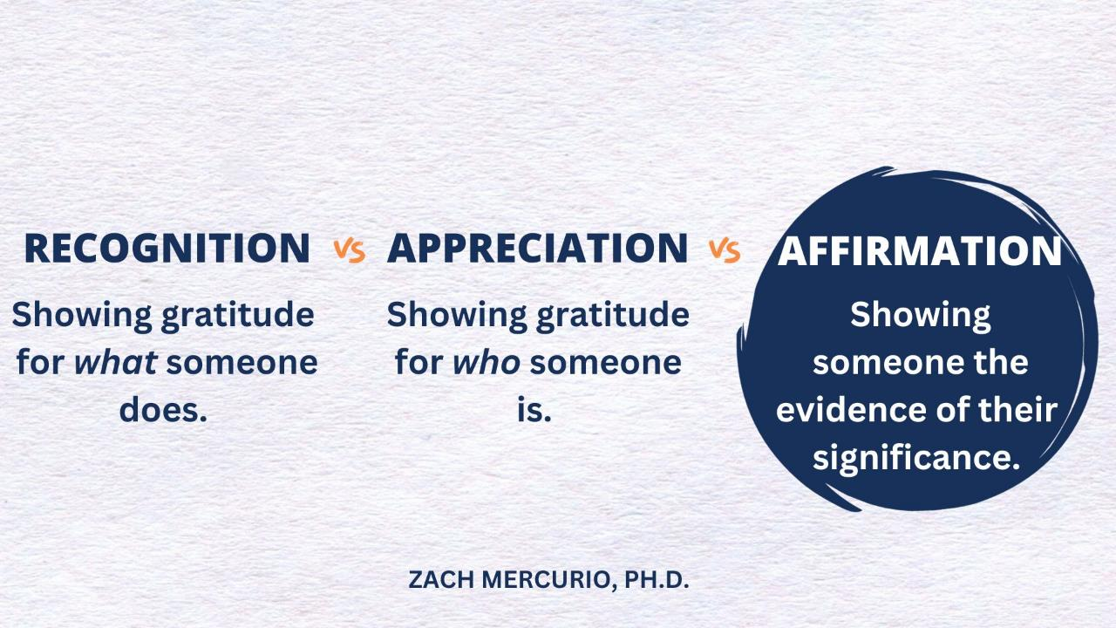

Slide 38

NEEDED
“If it weren’t for you…”
Tell people why you rely on them
Show people what they make possible
Give people real responsibility.

Slide 39


Slide 40
There is nothing more powerful than a human being who believes they matter.

Slide 41
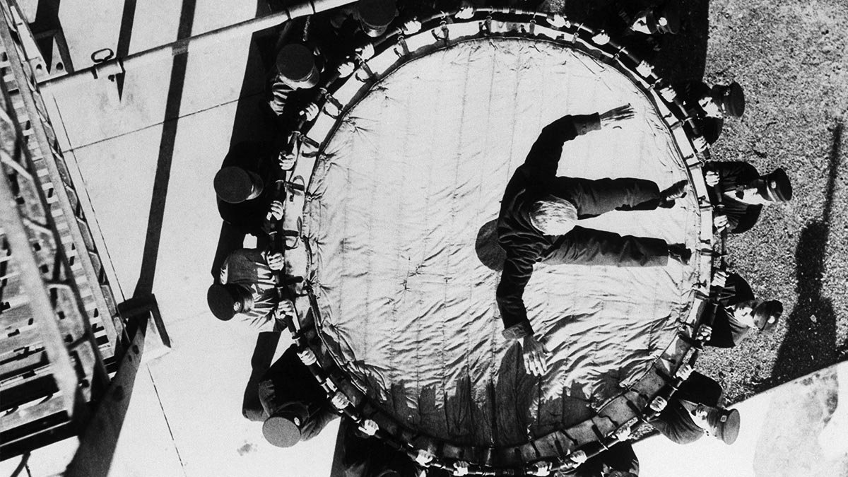
TRUST
Notes:
Based on my experience working with teams over the past decade I’ve come to one inescapable conclusion – one characteristic above all others is trust
Ufortunately it’s probably to rarest
Why is it so rare?
First eope use the word inconsistently trust means different things to different people and secondly it’s just hard
Best way to start is defining what we mean by trust gap in trust between managers and employees can have profoundly negative effects on team productivity and engagement. But when people feel trusted, they tend to offer trust in return.
ADPRI data 50,000 people globally as if trust teammates, team leader and senior leaders
2 of 3 categories – 3 times more likely to be fully engaged and highly resilient
All 3 - 15 times more engaged 42 times more resilient

Slide 42
HOW DO YOU DEFINE
TRUST?
WHAT DO I NEED TO DO FOR YOU TO TRUST ME?
Notes:
Trsut is about vulnerability
Team members who trust one another learn to be comfortable being open. Exposed to one another around their failures weaknesses and even fears
Now this is not some nicey, nicey touchy feely sort of things – its not
It’s the idea that people who aren’t afraid to amit the truth about themselves are not going to engage in the kind of political behaviour that wastes everyones tie and energy
It’s not about titles or positions - you haver to earn it and you can lose it fast and then takes for ever to build it back up
Trust is not only important it’s the bed rock upon which great leadership stands

Slide 43

Change
THE FIVE DYSFUNCTIONS OF A TEAM
BY PATRICK LECIONI
Failure to hold one another to account creates an environment where an inattention to results occurs. This is where team members put their needs (such as ego, career or recognition) or even needs of their functions above the collective goals of the team.
Inattention to results
Avoidance of accountability
With no real commitment and buy-in, team members develop an avoidance of accountability. Without committing to a clear plan of action, even the most focused and driven people often hesitate to call out their peers on actions and behaviour that seem counterproductive to the good of the team.
A lack of healthy conflict ensures the third dysfunction: Lack of commitment. Without having aired their opinion in the course of passionate and open debate, team members rarely, if ever buy-in and commit to decisions, though they may pretend to agree during meetings.
Lack of
commitment
A failure to build trust sets the tone for the second dysfunction: fear of conflict. Teams that lack trust are incapable of engaging with unfiltered and passionate debate of ideas, resorting instead to veiled discussions and guarded comments.
Fear of conflict
An absence of trust essentially stems from an unwillingness to be vulnerable within the group. Team members who are not genuinely open with one another about their mistakes and weaknesses make it impossible to build a foundation of trust.
Absence of TRUST
Notes:
In his work Lencioni talks about the five dysfunctions of a team where vulnerability-based trust is the bed rock almost the bottom level of Maslow’s hierarchy of needs for your team. Team members who are not genuinely open with each other about mistakes and their weaknesses make it impossible to build a foundation of trust.
He goes on to say a failure to build trust sets the tone for his second dysfunction a fear of conflict. Teams that don’t trust each other are incapable of having unfiltered and passionate debates on ideas, instead they keep quiet or make guarded comments. A lack of healthy debate leads to the third dysfunction that of a lack of commitment, without having aired their opinions or feel that they have been heard as part of these passionate debates then they naturally never really buy in the decisions that are made – although they may well pretend to agree when in the meeting. With no real commitment to the decisions or way forward that’s ‘agreed’ people develop a lack of accountability. Without agreeing to a clear plan of action even the most focused and driven people often hesitate to call out fellow team members on behaviours that undermine and appear counterproductive to the good of the team and so with a failure to hold each other to account this creates an environment where they are no really focused on results, it creates an environment where they are more focused on their own individual needs like satus, career or recognition of their own functions above anything that’s good for the whole team.

Slide 44
“Vulnerability is the birth place of
innovation, creativity and change.”

Slide 45

WHAT COULD YOU AND YOUR ORGANISATION DO TO BUILD VULNERBILITY BASED TRUST?

Slide 46
WHEN PEOPLE KNOW THEY MATTER AND EXPERIENCE PURPOSE IN A CONNECTED AND SAFE ENVIRONMENT, RESEARCH FINDS THEY AND THEIR Organisations THRIVE.

Slide 47
How do we create an environment where people can work at their natural best?

