Slide 1
AI: From Concept to Competitive Advantage
Breakout Session 2
Colin Stokes and Tom Shrive, Adiuvo
Integrate
Breakout Room

Slide 2

Notes:
Intro myself

Slide 3
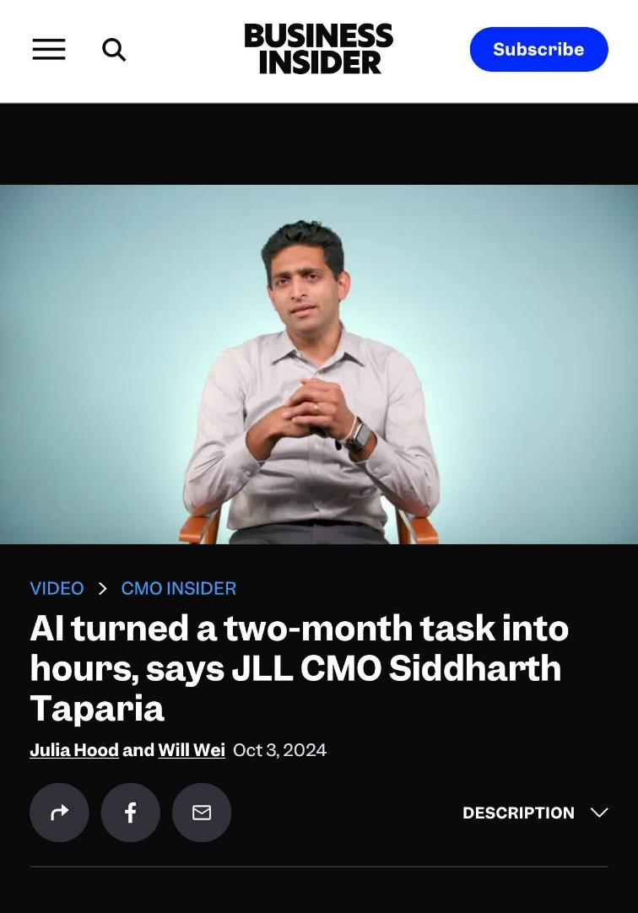
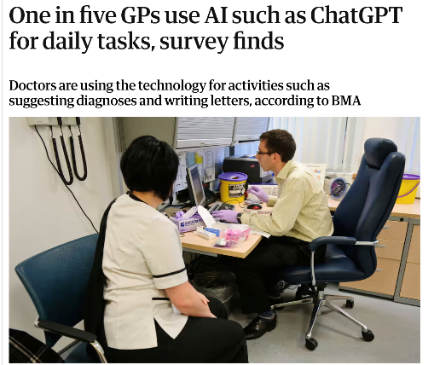
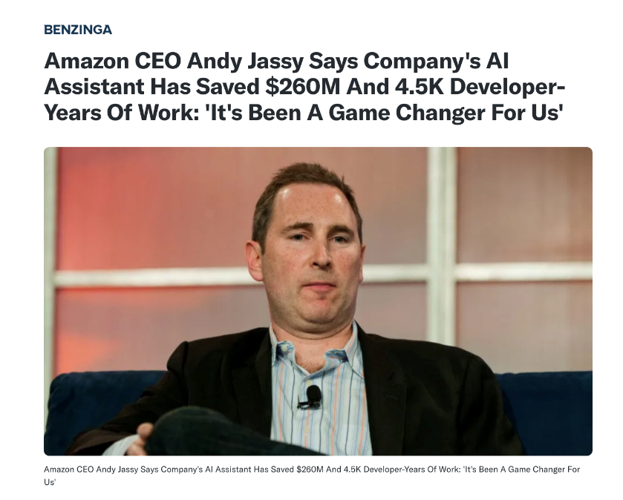
"More than half of employees using GenAI report saving at least 5 hours a week."
Forbes study with over 13,000 people in 15 countries
Notes:
Show case some examples from other sectors

Slide 4
AGENDA
What is AI?
How does AI learn?
What can AI do?
Some examples…
How can I make AI work for me?
Things to watch out for
Final Take aways
Notes:
Intro the presentation

Slide 5






AI – A MOTORBIKE FOR THE MIND...
Humans
Humans + computers
Humans + Computers + AI
Notes:
Talk about different ways AI can learn
"We've just looked at the ways AI can learn, much like a person:
Learning by teaching: where the AI learns from labelled examples, similar to how a student learns from a teacher.
Learning by reading: where AI explores data on its own and finds patterns, like a student discovering knowledge through self-study.
Learning by doing: where AI learns through trial and error, just like learning to skate.
These are the fundamental ways AI can gain knowledge and understanding."

Slide 6
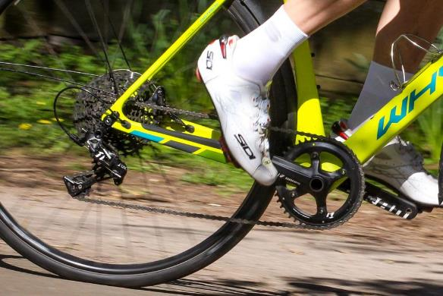

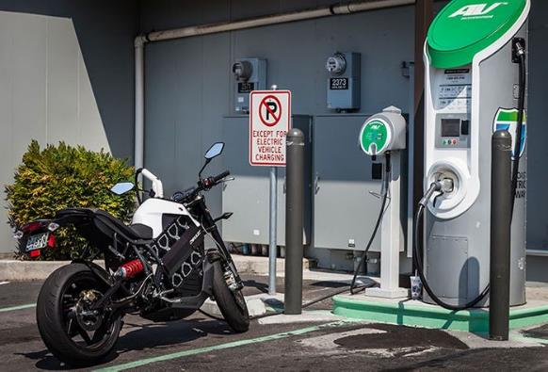

MOTORBIKES STILL NEED TO BE RIDEN...
Notes:
AI Removes all the pedaling
Still needs steering (Otherwise car crash)
It needs fuel / charging
Know where you want to end up

Slide 7



HOW AI LEARNS...
learns by teaching
(Supervised learning)
Learns by studying
(Unsupervised learning)
Learns by doing
(Reinforcement learning)
Notes:
Talk about different ways AI can learn
"We've just looked at the ways AI can learn, much like a person:
Learning by teaching: where the AI learns from labelled examples, similar to how a student learns from a teacher.
Learning by reading: where AI explores data on its own and finds patterns, like a student discovering knowledge through self-study.
Learning by doing: where AI learns through trial and error, just like learning to skate.
These are the fundamental ways AI can gain knowledge and understanding."

Slide 8

WHAT AI CAN DO...
Make Predictions
(Predictive AI)
Notes:
Talk about what that enables AI to do (I’ll give examples)
Make predictions: Whether predicting sales or diagnosing diseases, this is Predictive AI using what it's learned to anticipate outcomes.
Generate content: AI can now autonomously create text, music, or art, powered by Generative AI.
Make effective decisions: This is where AI uses what it's learned through trial and error to reason and make smart decisions, which is part of Reasoning AI. This area is still evolving, but it's making significant progress."

Slide 9

WHAT AI CAN DO...
Make Predictions
(Predictive AI)
Generate content
(Generative AI)
Notes:
Talk about what that enables AI to do (I’ll give examples)
Make predictions: Whether predicting sales or diagnosing diseases, this is Predictive AI using what it's learned to anticipate outcomes.
Generate content: AI can now autonomously create text, music, or art, powered by Generative AI.
Make effective decisions: This is where AI uses what it's learned through trial and error to reason and make smart decisions, which is part of Reasoning AI. This area is still evolving, but it's making significant progress."

Slide 10

WHAT AI CAN DO...
Make Predictions
(Predictive AI)
Generate content
(Generative AI)
Make effective decisions
(Reasoning AI)*
Notes:
Talk about what that enables AI to do (I’ll give examples)
Make predictions: Whether predicting sales or diagnosing diseases, this is Predictive AI using what it's learned to anticipate outcomes.
Generate content: AI can now autonomously create text, music, or art, powered by Generative AI.
Make effective decisions: This is where AI uses what it's learned through trial and error to reason and make smart decisions, which is part of Reasoning AI. This area is still evolving, but it's making significant progress."

Slide 11



Reasoning AI
AI excels at inductive reasoning
AI struggles at deductive reasoning
People might be mortal
IF
Sara is mortal
Peter is mortal
John is mortal
People
are
mortal
Colin
is a
person
Colin
is mortal
Notes:
Parking lot

Slide 12
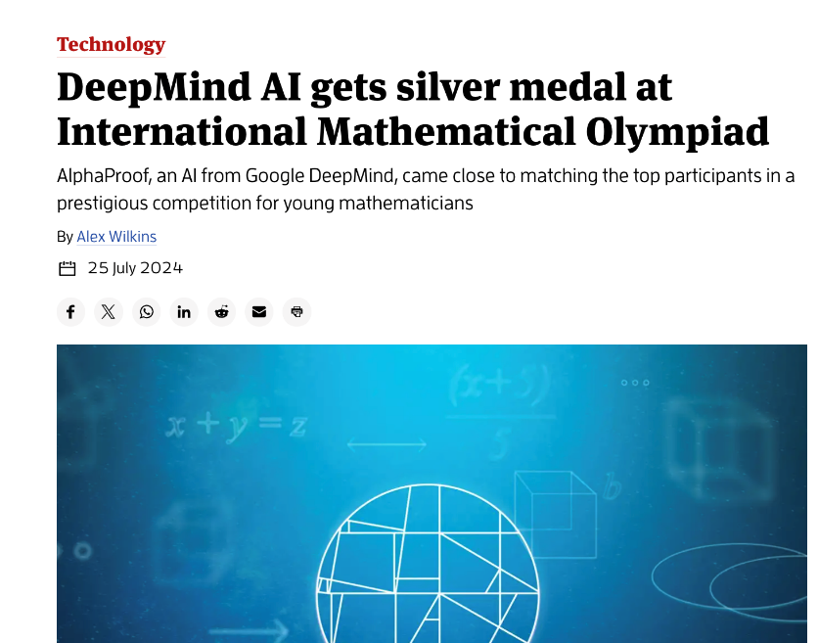
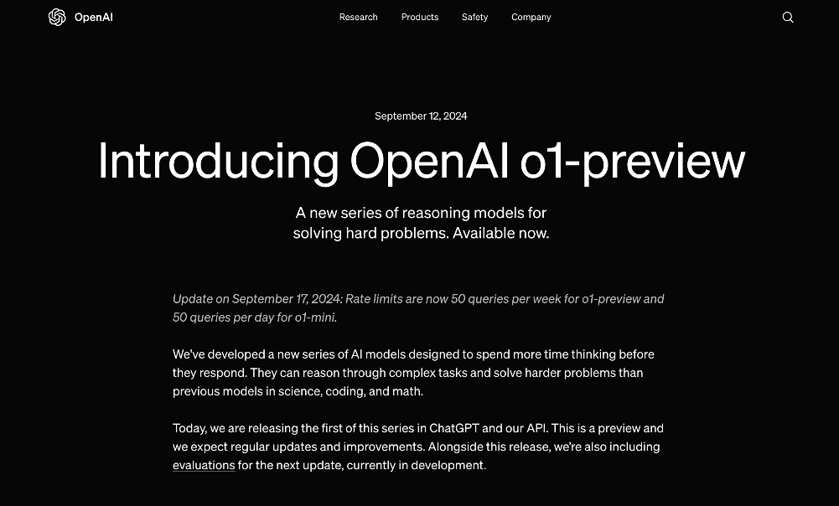
Reasoning AI
Notes:
Parking lot

Slide 13


Reasoning AI
Notes:
Parking lot

Slide 14




















OPPORTUNITIES IN OUR SECTOR
Onboarding | compliance | Maintenance | Finance | Managing Stakeholders | Policies | Major works | Managing suppliers | Technology
Bid /tender / proposal writing | Regulatory Compliance Monitoring | Automated Maintenance triage | Automated Financial Reporting | AI resident assistant | Policy Comparison and Analysis | AI-Based Project Planning | Performance Monitoring | IOT analysis and actioning
Data Validation |  | Automated Work Order Management | Fraud Detection | Meetings AI Automated Meeting Summaries | Claims Management | Cost Estimation | Contract Optimization | Coding
Automated Document Processing |  | Predictive maintenance |  | AI written communications |  |  | Automated outreach
Notes:
Talk about opportunities in this sector

Slide 15






MAKING AI WORK FOR ADIUVO
What’s all this for?
Map your goals and tasks
Identify biggest
wins
Prepare your data
Validate
Implement
Notes:
Explain approach to adopting AI

Slide 16


Strengths / opportunities | Challenges / threats
Deep proprietary sector knowledge Large valued client list Well placed to grow internationally Well placed to grow value proposition Technology | Data administration Quality assurance Training speed Recruiting Technology
Notes:
Talk about opportunities in this sector

Slide 17







BIG WINS FOR ADIUVO
Strengths, Opportunities, challenges & threats
 | AI resident & agent assistant | AI QA | AI Document Abstraction | AI Training | AI process automation
Proprietary sector knowledge
Support international growth
Grow value proposition
Reduce data administration
Improve quality assurance
Improve recruitment
Speed up training
Notes:
Talk about opportunities in this sector

Slide 18
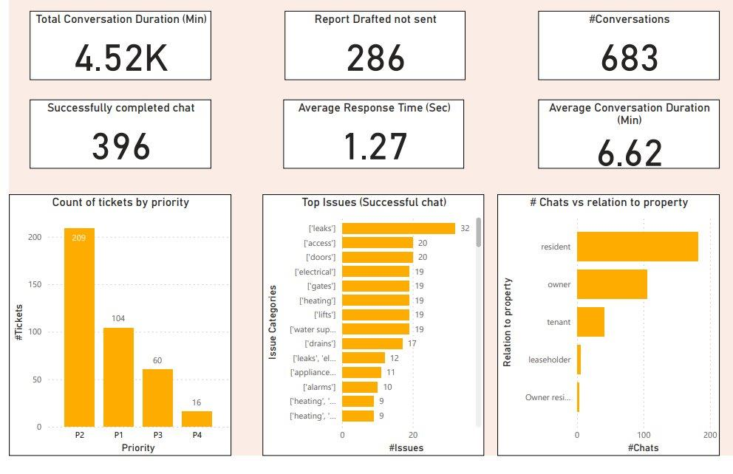
Example of AI in action - Adi stats
Notes:
Start sensibly, focus on where you get the best ROI

Slide 19




WHERE YOUR VALUE LIES
100
10
1
Notes:
Talk about where the value lies… going back to the motorbike analogy – when delivering a package, no one cares how the delivery person got to their house, just whether it got there on time, in a good condition for a reasonable cost and delivered with a smile.

Slide 20

SCALE YOUR VALUE
100
10
1
Humans
Humans +
Computers
Humans + Computers
AI
Notes:
If you get it right, you’ll be able to deliver a lot more value to customers for a lot less effort, and much bigger scale. Apply the delivery analogy to properties.

Slide 21

Do more of what your
customers really value.
Notes:
What this means. Use AI to enable you to spend more time delivering your unique human value to your clients. Don’t spent time doing things that don’t directly add value to your customers.

Slide 22

Free (forever)
AI assistant trained with
Building Safety Act &
Leasehold Reform Act
linkedin.com/in/tomshrive/
2
Notes:
Last slide

Slide 23
Thank you for listening.
Any Questions?

