Slide 1
Guide to Compliance Review
Breakout Session 2
Glenys Diebelius and Waqas Mahmood, TPI
Interact
Breakout Room

Slide 2
Overview
Team Introduction
The Purpose of a Compliance Review
2025 and Beyond
Compliance Review Process
Information Request
Box Application
What is covered in a Compliance Review?
  2.0 Instructing a Managing Agent
  3.0 Client Matters
  4.0 Financial Matters
  5.0 Legal Matters
  7.0 Disputes & Terminations
Compliance Review
Debrief / Findings Meeting
Report
What Happens Next?

Slide 3
Team Introduction
Glenys Diebelius MAAT ATPI
Compliance Review Team Lead
Glenys brings over 30 years of expertise in the Property Management Sector. She began her career in Residential Management before transitioning into the commercial field.
After spending a decade at Jones Lang LaSalle, where she rose to the position of Associate Director in the Corporate Solutions department, Glenys returned to residential management with a focus on ensuring Compliance. She worked with two local managing agents to help them meet RICS regulations.
In 2018, Glenys joined the Royal Institution of Chartered Surveyors as a Technical Specialist, and in October 2022, she transitioned to TPI as Audit Team Lead.
Waqas Mahmood ACA
Compliance Reviewer
Waqas is a member of the Institute of Chartered Accountants in
England and Wales.
He began his career with KPMG as a Public Sector Auditor, working
with clients in health, education, housing, and local government. He
then moved on to become a Compliance Inspector, conducting regulatory reviews of Environmental Bodies, and later served as a Compliance Accountant within the European Finance Shared Services team, supporting UK, French, and German businesses in compliance
with accounting and SOX standards.
Waqas joined RICS in 2014, gaining expertise in Client Money and Insurance Regulation; transferred to TPI as an Auditor in October 2022.

Slide 4
The Purpose of a Compliance Review
Goal Number One | Goal Number Two | Goal Number Three
Raising Standards | Support | Regulation Ready
At TPI, we aim to ensure that standards from our Member Firms are kept high. We can achieve this through the Compliance Review by comparing our Member Firms Systems, Controls, Processes, and Procedures against our Consumer Charter & Standards. | At TPI, we are here to provide support and guidance every step of the way. During the Compliance Review where we see areas of Non-Compliance, we will support you to come back into compliance. We are not here to tell you off. | At TPI, we’re committed to ensuring our Member Firms are fully prepared when new regulations take effect. Regulatory changes have been discussed for years, but this time, they are on the horizon. We want our Member Firms to be ready when they arrive, and our Compliance Reviews are designed to help you stay ahead and be fully compliant.

Slide 5

2025 and Beyond

Slide 6
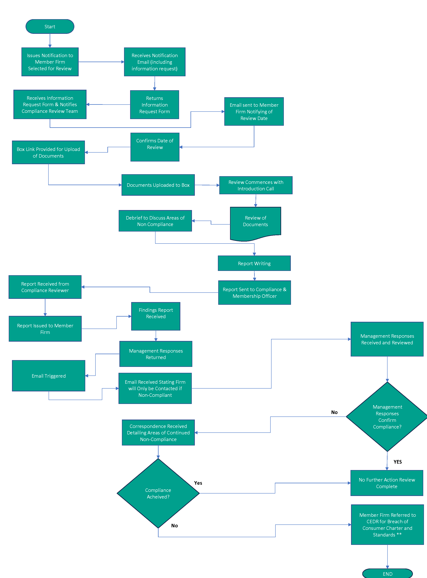
Compliance Review Process

Slide 7

Information Request
Why do we request information?
Why do we request it so early?
What if the information changes?
What happens if I don’t give you the
information within the time-scales?

Slide 8
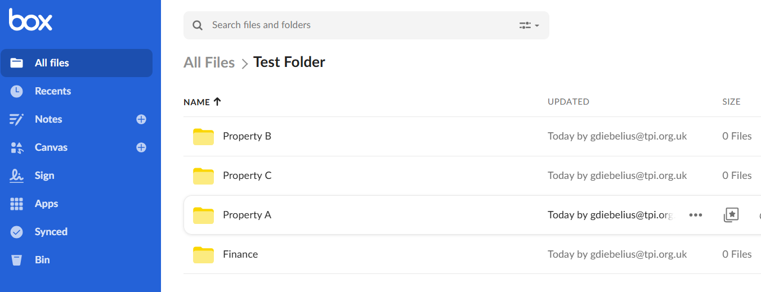
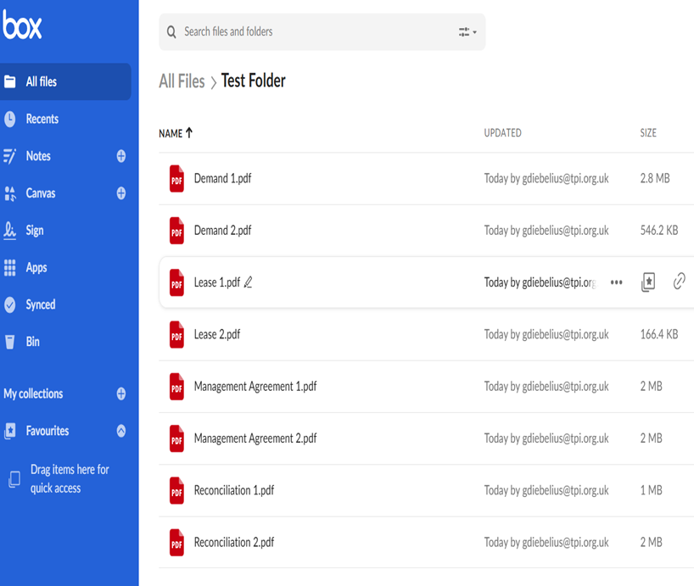
Box

Slide 9
What is Covered in the Compliance Review?

Slide 10

What we look at:

Slide 11
Compliance Review
Ensure you have uploaded all documents by the deadline
Reviews start with an introductory telephone or video call
Have key staff available on the review days:
  Property Manager
  Accounting Staff
Be prepared to upload further documents if required.

Slide 12

Debrief / Findings Meeting
Discussion of any instances of non-compliance
Opportunity to dispute any findings & present
further evidence
Recommendations given to come back into
compliance
Next steps.

Slide 13
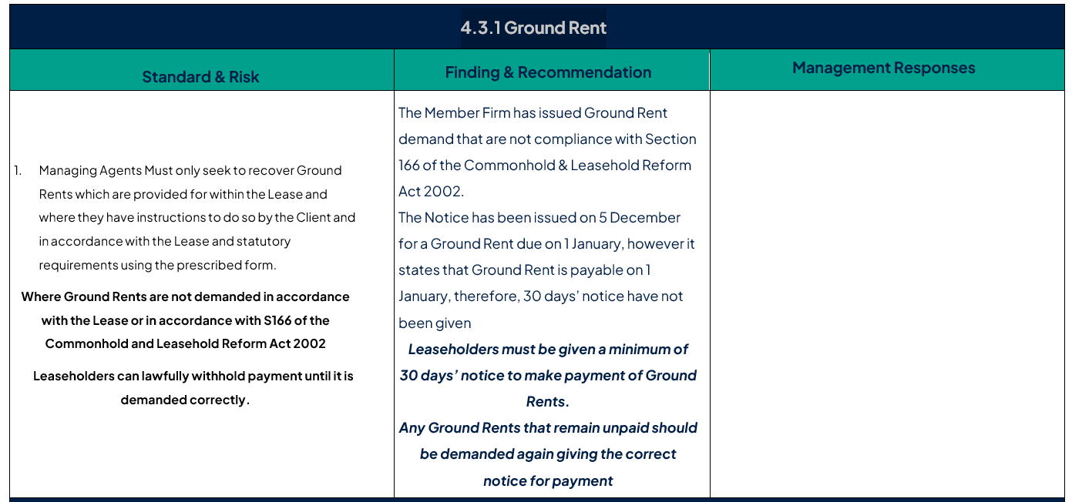
Compliance Report

Slide 14
Next Steps
  Report issued within 10 working days of end of review
  Management Responses to be returned within 20 working
  days of the report received
  Management Responses reviewed by TPI Technical Officer
  If Compliant – No further action required
  Non-Compliant – Further guidance / Disciplinary measures.

Slide 15
Thank you for listening.
Any Questions?

