Slide 1
What is Happening with Insurance Premiums
Breakout Session 1
Rob Mayo, Insurety
Interact
Breakout Room

Slide 2




Slide 3


An Intro to
Founded by Rob Mayo in January 2020
TPI Partner Broker
Team of 22 across 3 offices
Insuring 8,228 developments
Formed in June 2023, Insurety Protect now insures over 2,000 developments.

Slide 5
Average Premium Increases in the Building Sector Between 2018 and 2023

Slide 6
£174.74b
£20.95b
spent in premiums on
Property and Liability lines in 2023
accrued in 2023 through
Insurance Premium Tax (IPT) (12%)
A 3% increase to 15% would increase treasury income by £5.26b to £26.21b
A 8% increase to 20% would increase treasury income by £13.99b to £34.94b
The average premium per block is £5,800 per year.
A 20% increase in IPT would result in a new premium of £6,284 per year.

Slide 7
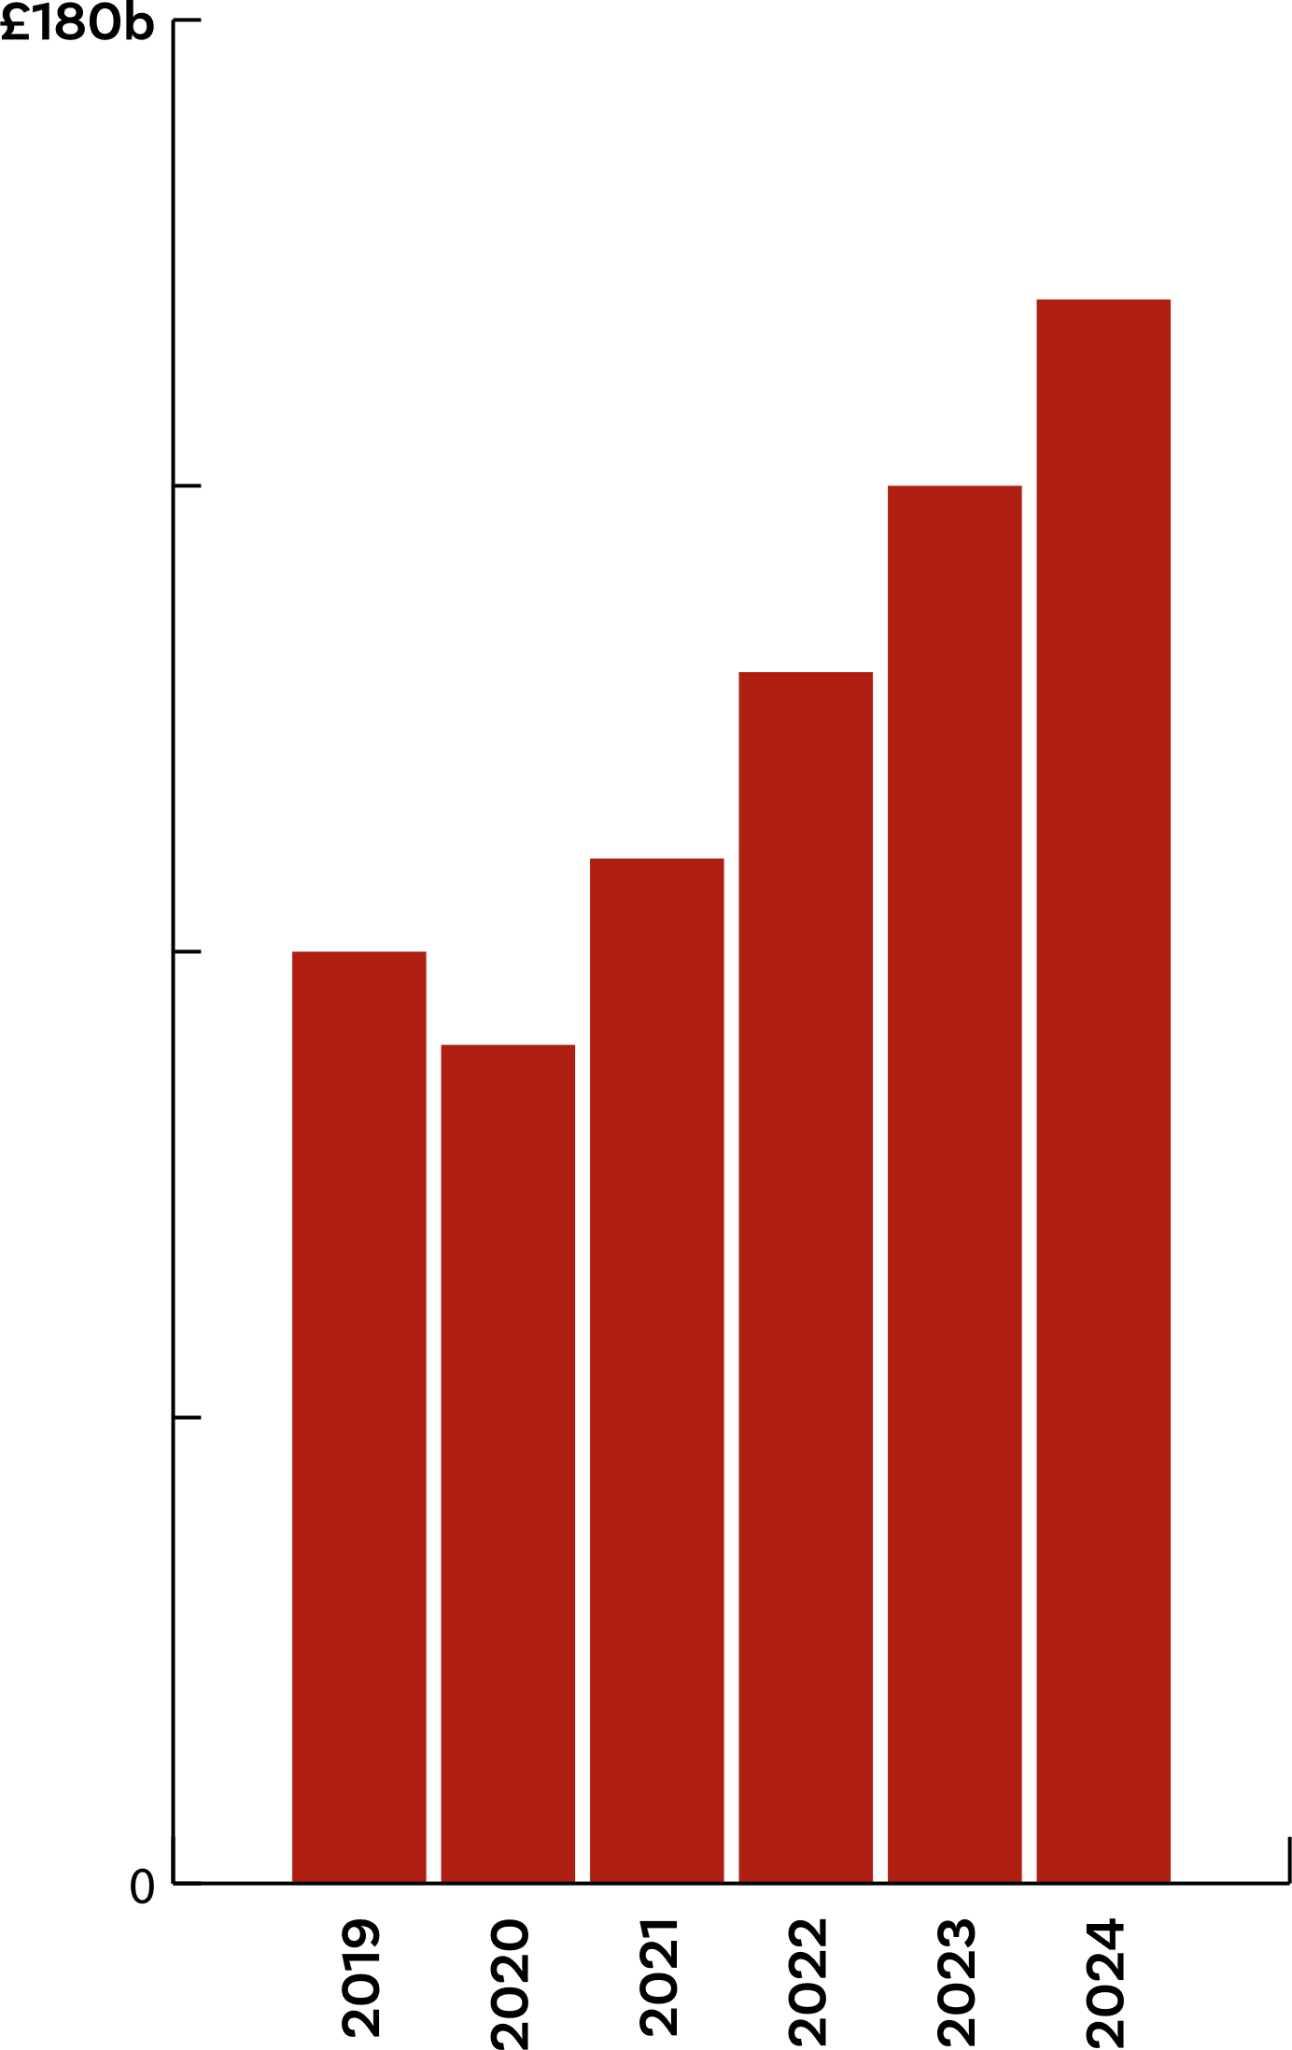
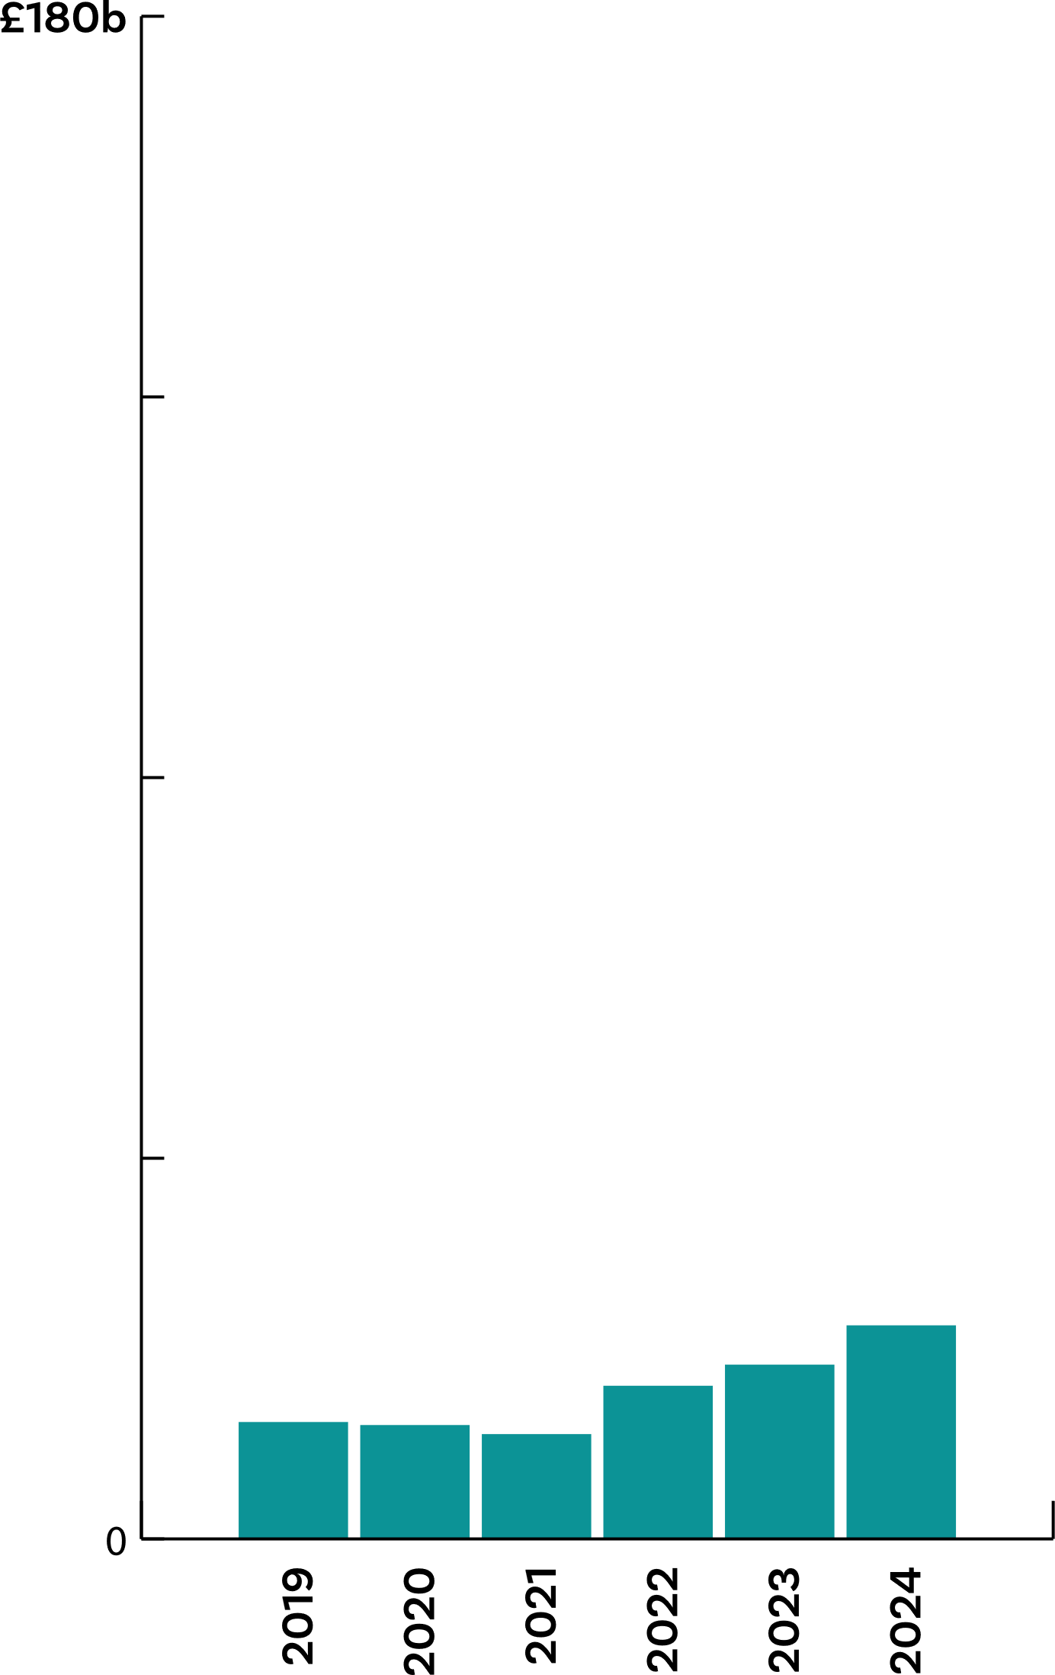
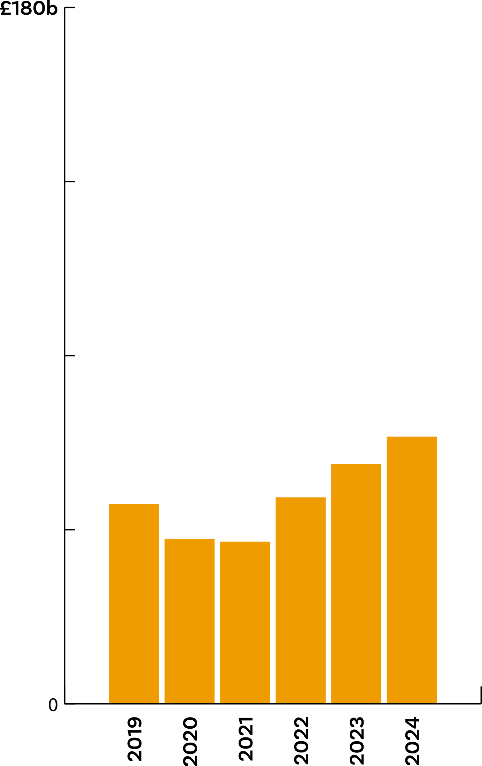
Annual Spend on Insurance (2019-2024)
Property
Insurance
Employers’
Liability
Public
Liability

Slide 8
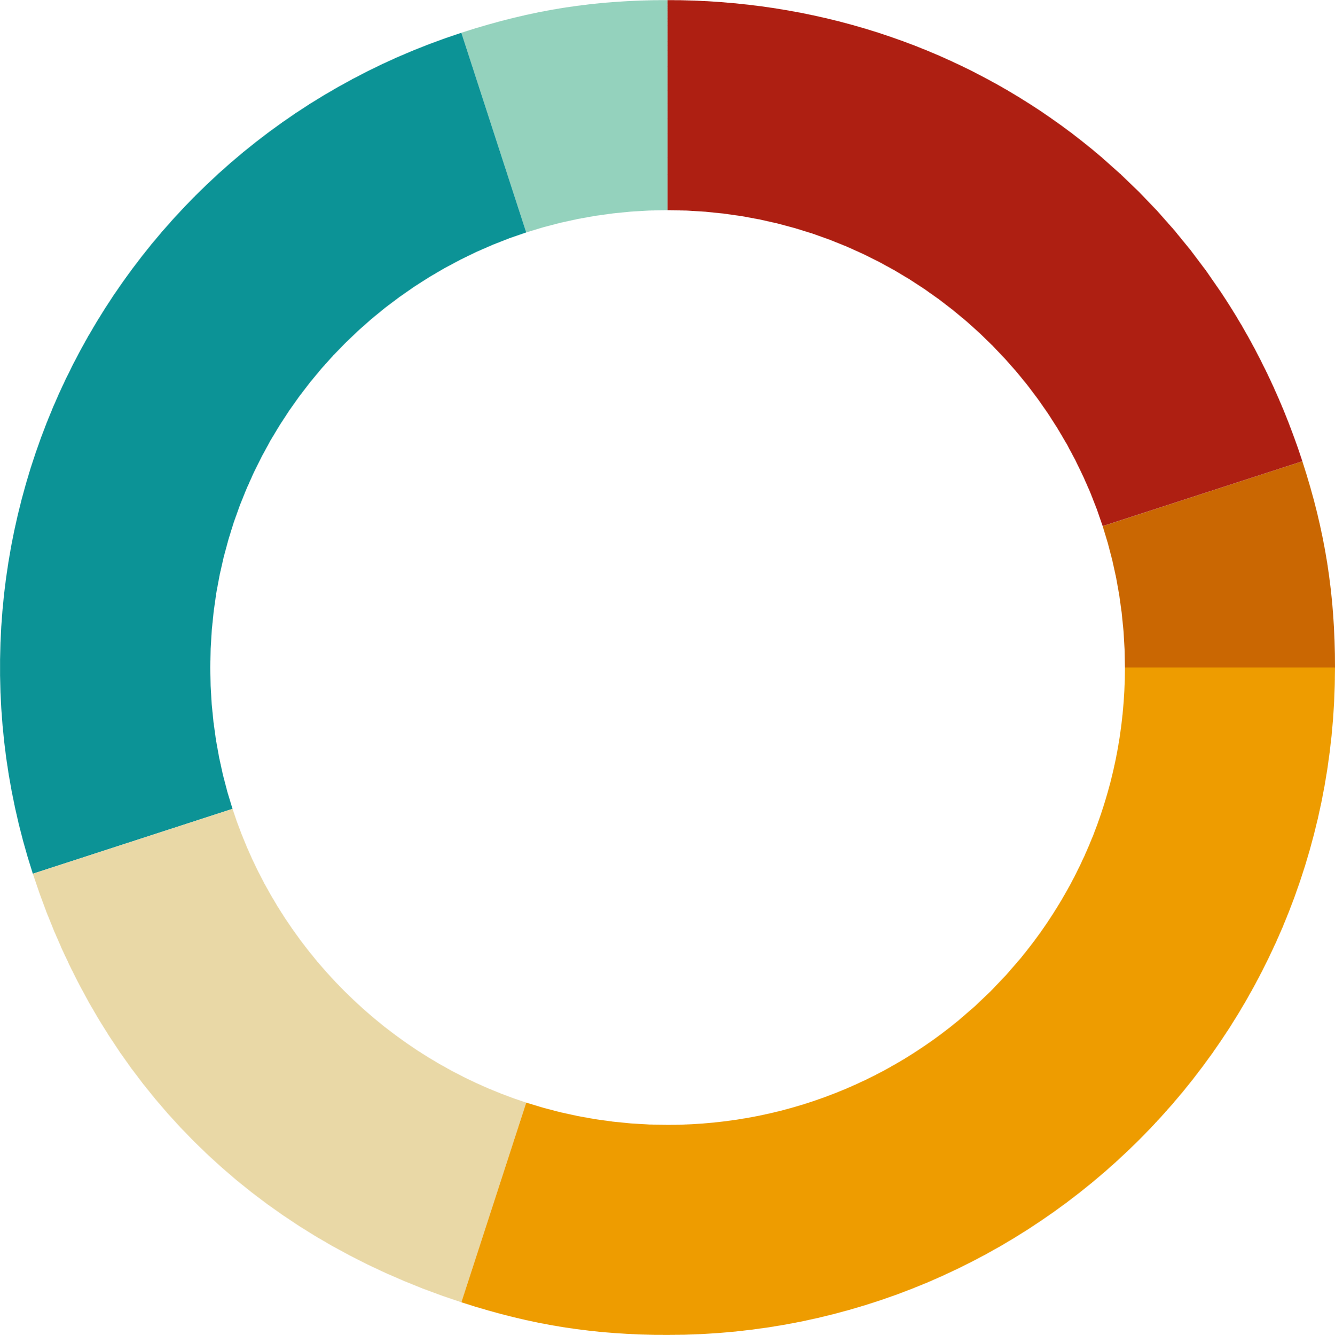

Where insurers are feeling pain
is why insurance premiums are increasing.
Core Operating Ratio
(COR) of
135%
Every £1 gained
costs insurers £1.35
20% insurer staff costs
5% insurer retirement schemes
30% insurance broker commissions
15% insurer premises costs
25% claims
5% insurer profit margin
20% insurer staff costs
5% insurer retirement schemes
30% insurance broker commissions
15% insurer premises costs
65% claims
5% insurer profit margin

Slide 10
Over £997m
Over £1.15b
Over 86%
paid in water claims in
2022, equating to
£2.75m every day
expected claims data in 2023, equating to
£3.2m every day
of all claims are
water-related
Water claims are no longer a ‘winter phenomena’ –
they’re now consistent throughout the year.
Claims inflation continues to increase – the average claim was around £2,800 in 2000 compared to £30,000 in 2019
67% of EOW claims occur due to faulty pipe joints from poor workmanship
New water committee now formed within MHCLG to address the problem within new and existing developments.

Slide 11
What can be done now to reduce premiums?
Thoroughly check Statements of Fact
Ensure RCAs are done every 3 years
Understand the insurer’s clauses, in particular with flat roof areas and guttering
Openly engage with LHs to ensure they are aware of the risks, check seals in bathrooms etc.
For distressed developments, work with your broker/insurer to form a plan of ‘remediation’
Educate landlords on their responsibilities during void periods
Ensure a robust claims process is in place – brokers should support PMs with this
Make sure trees are pruned, especially those in close proximity to buildings.

Slide 12
Don’t be afraid to ask and understand!
Brokers should be issuing a Fair Value statement to PM’s
Remuneration Disclosure documents to be issued per case
Carefully check the SoDaN documents to ensure clients requirements are met
Ensure you understand brokers earning requirements
Do not be afraid of talking about commissions with your broker!

Slide 13
Thank you!
Any questions?

